Slide 1
Brain Tumor Detection Using Convolutional Neural Network
Team Members
Prashun Roy
ID : 1206018
MD. Hasibul Hasan Raad
ID : 1206016
Syeda Tamanna Hossain
ID : 1206015
Maisha Mahmud
ID : 1206019
MD. Minhajul Islam
ID : 1205029
Rabeya Sultana
ID : 1206020
Zahid Hasan
ID : 1206001
MD. Maruf Hasan
ID : 1206003

Slide 2
CONTENTS
Introduction and Motivation
Dataset
Data Preprocessing
Building the CNN
Training
Result and Challenges
Conclusion

Slide 3
Introduction and Motivation
Brain Tumor is one of the most dangerous disease which require early and accurately detection methods.
Now most detection and diagnosis methods depend on decision of neurology specialist and radiologist for image evaluation which possible to human errors and time consuming.
The main purpose of this project is to build a robust CNN model that can classify if the object has a tumor or not based on Brain MRI scan images with an acceptable accuracy for medical grade application.

Slide 4
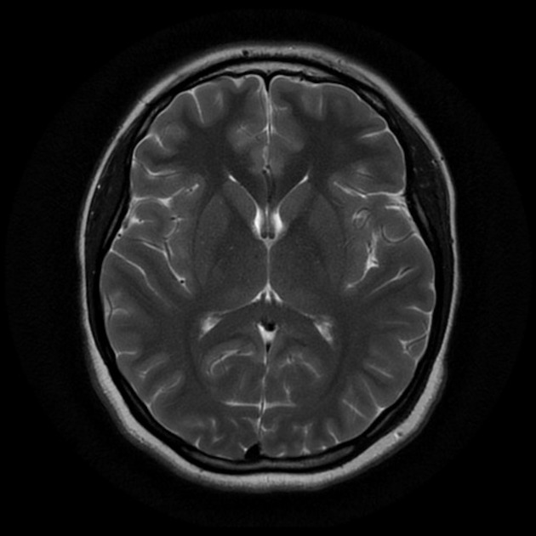
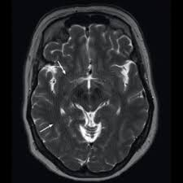
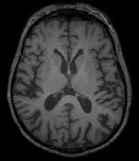
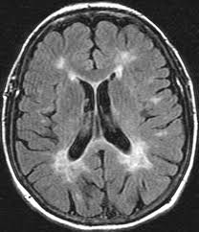
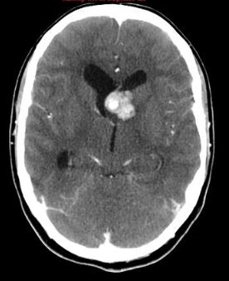
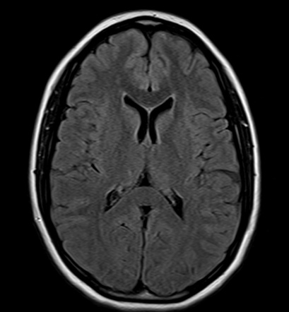
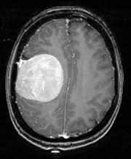
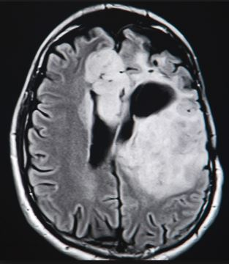
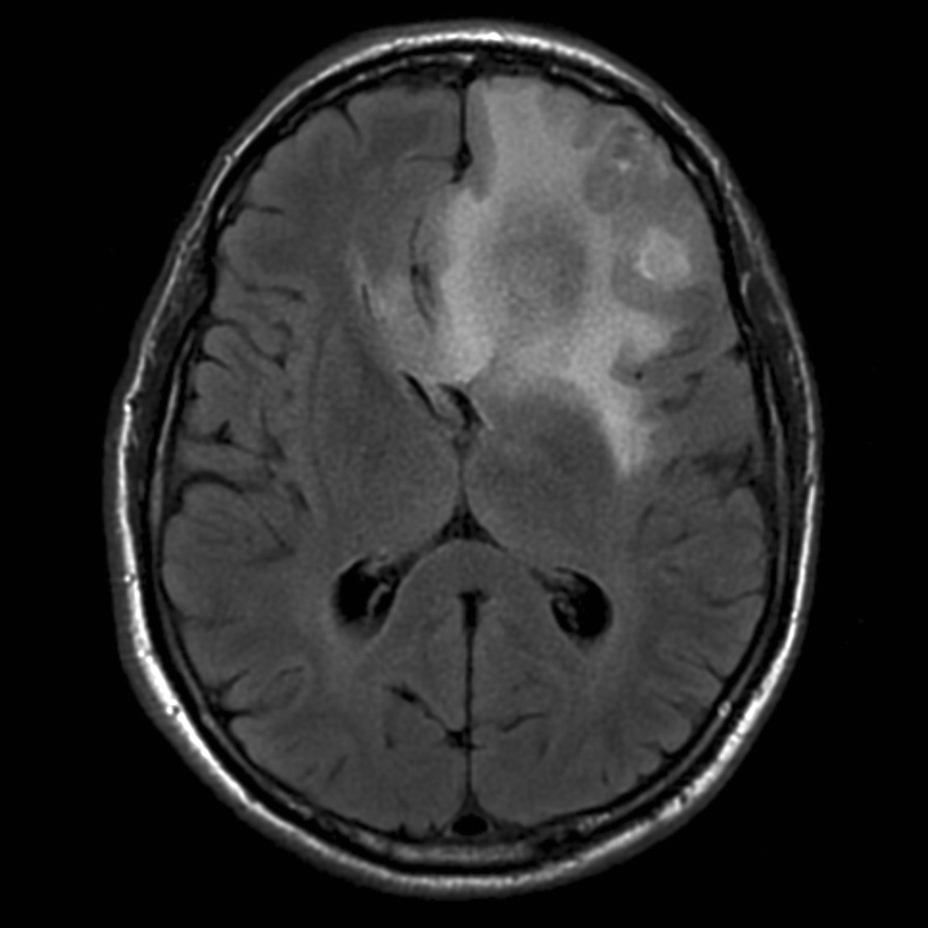
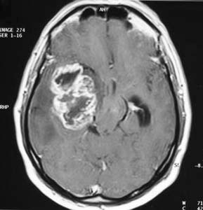
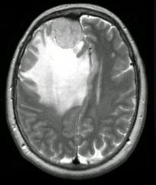
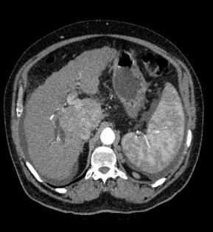
Data Source
No tumor (98 images)
With tumor (155 images)
Data source : https://www.kaggle.com/navoneel/brain-mri-images-for-brain-tumor-detection

Slide 5
Image Preprocessing
Image
Contouring
Image
cropping
Image
Resize
Horizontal
flip
Image
Normalization
Image MRI
input
Preprocessed
Images
Encoding
Images

Slide 6
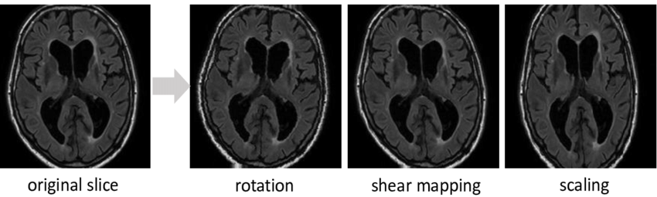
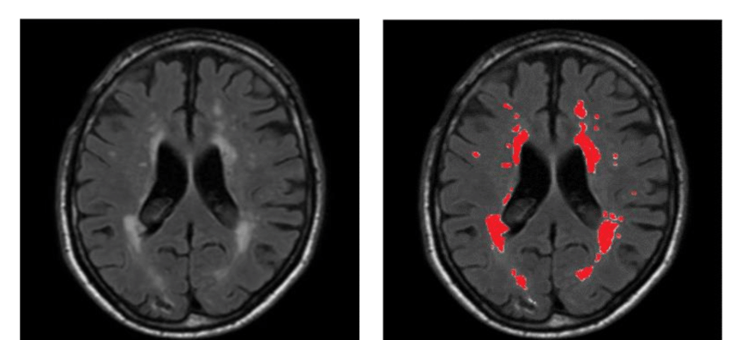
Data Augmentation
Here we used the “ImageDataGenerator ” provided by Keras for data augmentation to
It replace the original batch with the new, randomly transformed batch of images
For augmentation the following operation were applied : rotation_range, rescale , shear_range
zoom_range, horizontal_flip , target_sizebatch_size
Data source : https://www.researchgate.net/figure/Overall-framework-for-the-testing-stage_fig3_323184305

Slide 7
Building the CNN
Convolution
Flattening
Step 2
Step 4
Step1
Step 3
Pooling
Full Connection
Output Layer
Step 5
Additional convolution layer

Slide 8
Building the CNN
The definition of a good model for us was high test and validation accuracy
To establish baseline, we used of a 3 kernel layer and 64 Gaussian filters of convolution and ReLU activation function.
We used deep CNNs with multiple rounds of convolution and max pool size
Pooled layer flattered by the Flattening function of Keras.
In output layer we used sigmoid activation function, also called the logistic function for single unit of data

Slide 9
Training
Compile the CNN using Adam optimization algorithm. Adam can efficiently solve practical deep learning problems.
We used 25 epochs
The number of epochs used to train a neural network model is more than necessary, the training model learns patterns that are specific to sample data to a great extent

Slide 10
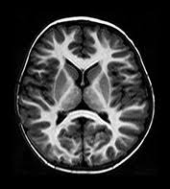
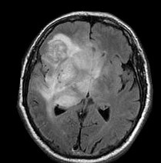
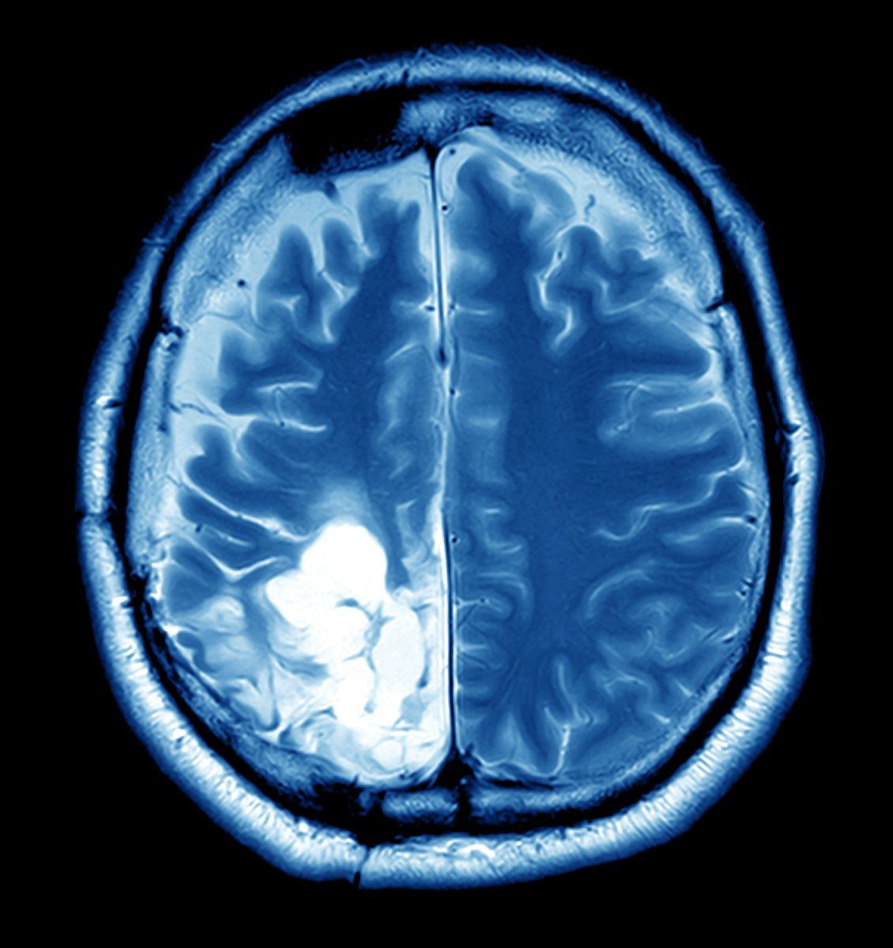
Single Prediction
We used 3 test cases for prediction

Slide 11
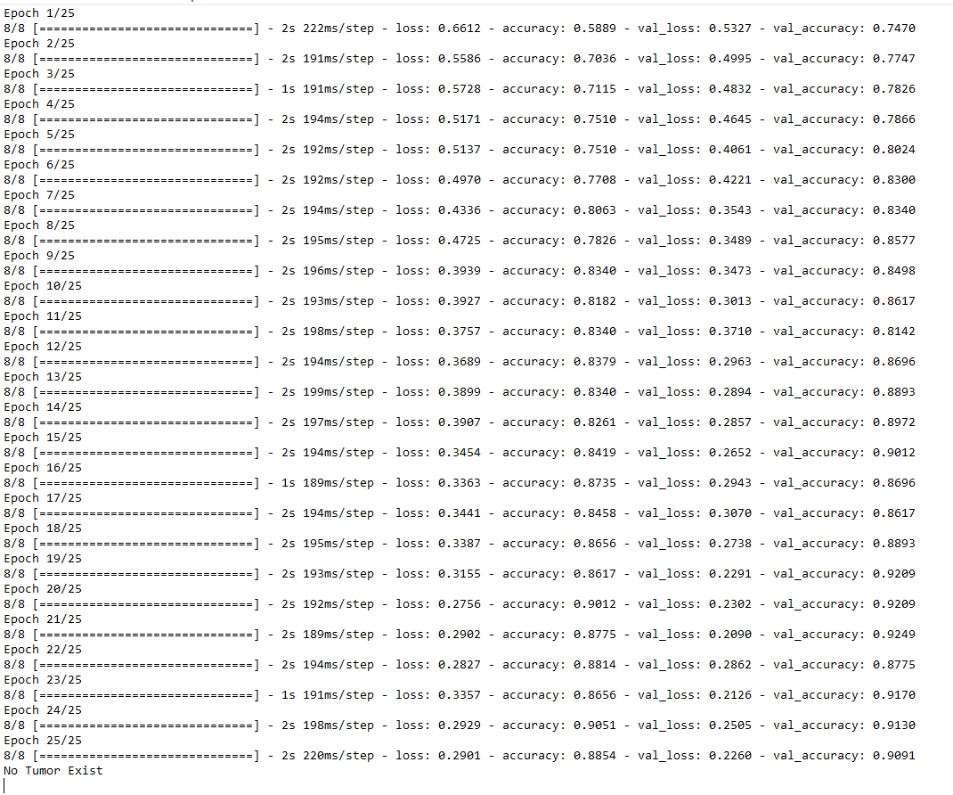
Result with high accuracy

Slide 12
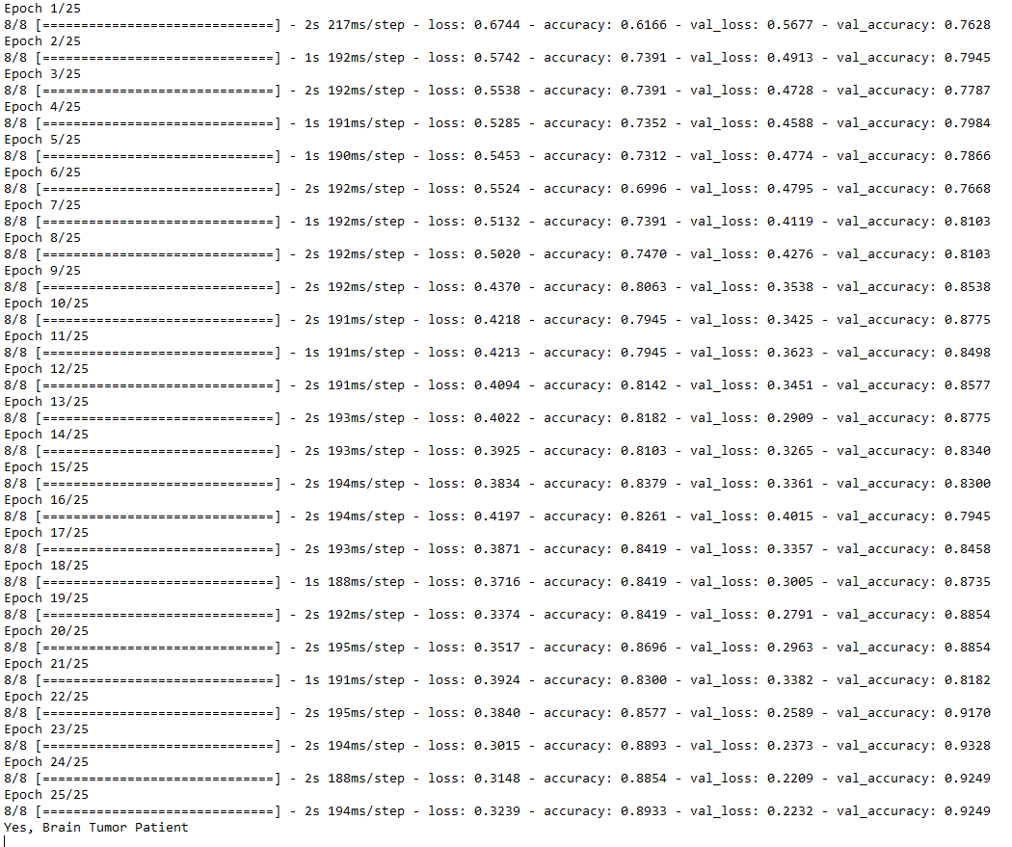
Result with high accuracy

Slide 13
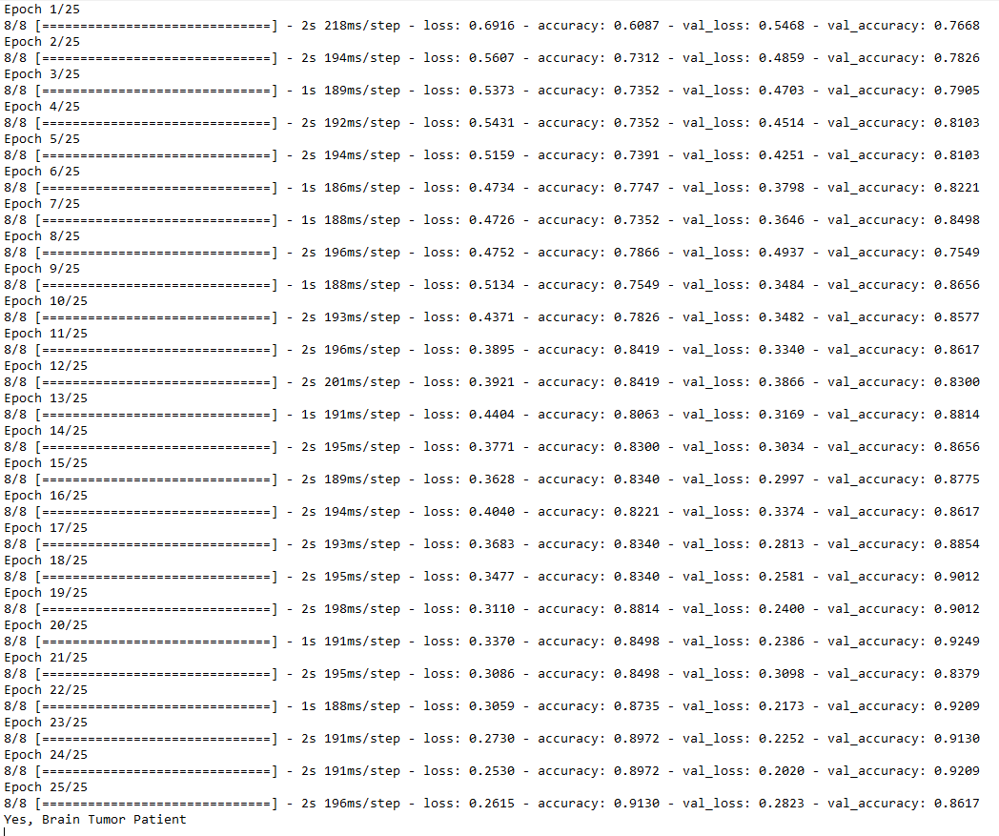
Result with high accuracy

Slide 14
Conclusion
The Model is able to create and train that give us very high accuracy on unseen data using relatively low input data (~253 images )
Proper image processing based on the problem statement is what separates a good model from a bad one.
Transfer learning can simplify even complicated problem with the drawback of computation time.

Slide 15
Thank You

